Slide 1
Natural Language Processing
Anshu Pandey

Slide 2

What is NLP?
The process of computer analysis of input provided in a human language (natural language), and conversion of this input into a useful form of representation.
The field of NLP is primarily concerned with getting computers to perform useful and interesting tasks with human languages.

Slide 3
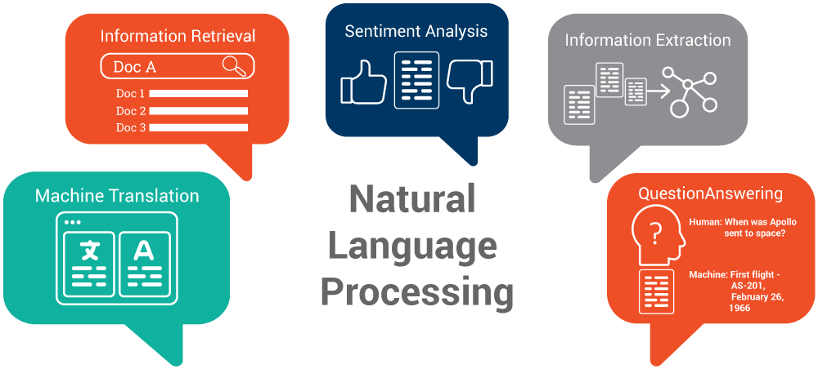

Slide 4


What is Natural Language Processing (NLP)
The process of computer analysis of input provided in a human language (natural language), and conversion of this input into a useful form of representation.
The field of NLP is primarily concerned with getting computers to perform useful and interesting tasks with human languages.
The field of NLP is secondarily concerned with helping us come to a better understanding of human language.

Slide 5


Components of NLP
Natural Language Understanding
Mapping the given input in the natural language into a useful representation.
Different level of analysis required:
morphological analysis,
syntactic analysis,
semantic analysis,
discourse analysis, …
Natural Language Generation
Producing output in the natural language from some internal representation.
Different level of synthesis required:
deep planning
syntactic generation

Slide 6

Forms of Natural Language
The input/output of a NLP system can be:
written text
speech
To process written text, we need:
lexical, syntactic, semantic knowledge about the language
discourse information, real world knowledge
To process spoken language, we need everything required to process written text, plus the challenges of speech recognition and speech synthesis.

Slide 7


Why NL Understanding is hard?
Natural language is extremely rich in form and structure
One input can mean many different things. Ambiguity can be at different levels.
Many input can mean the same thing.
Interaction among components of the input is not clear.

Slide 8
Knowledge of Language
Phonology – concerns how words are related to the sounds that realize them.
Morphology – concerns how words are constructed from more basic meaning units called morphemes. A morpheme is the primitive unit of meaning in a language.
Syntax – concerns how can be put together to form correct sentences and determines what structural role each word plays in the sentence and what phrases are subparts of other phrases.
Semantics – concerns what words mean and how these meaning combine in sentences to form sentence meaning. The study of context-independent meaning.

Slide 9
Knowledge of Language
Pragmatics – concerns how sentences are used in different situations and how use affects the interpretation of the sentence.
Discourse – concerns how the immediately preceding sentences affect the interpretation of the next sentence. For example, interpreting pronouns and interpreting the temporal aspects of the information.
World Knowledge – includes general knowledge about the world. What each language user must know about the other’s beliefs and goals.

Slide 10
Natural Language Understanding
Speech Recognition
Pragmatics
Syntactic Analysis
Semantic Analysis
Input/Output data
Sentence structure
He loves Mary
Sentence meaning
loves(john,mary)
Frequency spectrogram
Word sequence
“He Loves Mary”
Partial Meaning
Ξx loves(x,mary)

Slide 11
Natural Language Understanding
Words
Morphological Analysis
Morphologically analyzed words
Syntactic Analysis
Syntactic Structure
Semantic Analysis
Context-independent meaning representation
Discourse Processing
Final meaning representation

Slide 12
Ambiguity
I made her duck.
How many different interpretations does this sentence have?
What are the reasons for the ambiguity?
The categories of knowledge of language can be thought of as ambiguity resolving components.
How can each ambiguous piece be resolved?
Does speech input make the sentence even more ambiguous?
Yes – deciding word boundaries

Slide 13
Ambiguity
Some interpretations of : I made her duck.
I cooked duck for her.
I cooked duck belonging to her.
I created a toy duck which she owns.
I caused her to quickly lower her head or body.
I used magic and turned her into a duck.
duck – morphologically and syntactically ambiguous:
noun or verb.
her – syntactically ambiguous: dative or possessive.
make – semantically ambiguous: cook or create.
make – syntactically ambiguous:

Slide 14
Morphological Analysis
Analyzing words into their linguistic components (morphemes).
Morphemes are the smallest meaningful units of language.
cars car+PLU
giving give+PROG
Ambiguity: More than one alternatives
wolf / wolves knife / knives switch / switches
flies fly_{VERB}+PROG
fly_{NOUN}+PLU

Slide 15
Lexical Processing
The purpose of lexical processing is to determine meanings of individual words.
Basic methods is to lookup in a database of meanings -- lexicon
We should also identify non-words such as punctuation marks.
Word-level ambiguity -- words may have several meanings, and the correct one cannot be chosen based solely on the word itself.
bank in English
Solution -- resolve the ambiguity on the spot by POS tagging
(if possible) or pass-on the ambiguity to the other levels.

Slide 16
Syntactic Processing
Parsing -- converting a flat input sentence into a hierarchical structure that corresponds to the units of meaning in the sentence.
There are different parsing formalisms and algorithms.
Most formalisms have two main components:
grammar -- a declarative representation describing the syntactic structure of sentences in the language.
parser -- an algorithm that analyzes the input and outputs its structural representation (its parse) consistent with the grammar specification.

Slide 17
Semantic Analysis
Assigning meanings to the structures created by syntactic analysis.
Mapping words and structures to particular domain objects in way consistent with our knowledge of the world.
Semantic can play an import role in selecting among competing syntactic analyses and discarding illogical analyses.
I robbed the bank -- bank is a river bank or a financial institution
We have to decide the formalisms which will be used in the meaning representation.

Slide 18
Discourse
Discourses are collection of coherent sentences (not arbitrary set of sentences)
Discourses have also hierarchical structures (similar to sentences)
anaphora resolution -- to resolve referring expression
Mary bought a book for Kelly. She didn’t like it.
She refers to Mary or Kelly. -- possibly Kelly
It refers to what -- book.
Mary had to lie for Kelly. She didn’t like it.
Discourse structure may depend on application.
Monologue
Dialogue
Human-Computer Interaction

Slide 19
Knowledge Representation for NLP
Which knowledge representation will be used depends on the application -- Machine Translation, Database Query System.
Requires the choice of representational framework, as well as the specific meaning vocabulary (what are concepts and relationship between these concepts -- ontology)
Must be computationally effective.
Common representational formalisms:
first order predicate logic
conceptual dependency graphs
semantic networks
Frame-based representations

Slide 20
Natural Language Generation
NLG is the process of constructing natural language outputs from non-linguistic inputs.
NLG can be viewed as the reverse process of NL understanding.
A NLG system may have two main parts:
Discourse Planner -- what will be generated. which sentences.
Surface Realizer -- realizes a sentence from its internal representation.
Lexical Selection -- selecting the correct words describing the concepts.

Slide 21
Natural Language Generation
Meaning representation
Utterance Planning
Meaning representations for sentences
Sentence Planning and Lexical Choice
Syntactic structures of sentences with lexical choices
Sentence Generation
Morphologically analyzed words
Morphological Generation
Words

Slide 22
Applications of Nat. Lang. Processing
Machine Translation
Database Access
Information Retrieval
Selecting from a set of documents the ones that are relevant to a query
Text Categorization
Sorting text into fixed topic categories
Extracting data from text
Converting unstructured text into structure data
Spoken language control systems
Spelling and grammar checkers

Slide 23
NLTK
The Natural Language Toolkit (NLTK) provides:
Basic classes for representing data relevant to natural language processing.
Standard interfaces for performing tasks, such as tokenization, tagging, and parsing.
Standard implementations of each task, which can be combined to solve complex problems.

Slide 24
Tokenization
The simplest way to represent a text is with a single string.
Difficult to process text in this format.
Often, it is more convenient to work with a list of tokens.
The task of converting a text from a single string to a list of tokens is known as tokenization.

Slide 25
Components of NLTK
Code: corpus readers, tokenizers, stemmers, taggers, chunkers, parsers, wordnet, ... (50k lines of code)
Corpora: >30 annotated data sets widely used in natural language processing (>300Mb data)
Documentation: a 400-page book, articles, reviews, API documentation

Slide 26


Word & Sentence Tokenizers
Tokenizers is used to divide strings into lists of substrings.
For example, Sentence tokenizer can be used to find the list of sentences and Word tokenizer can be used to find the list of words in strings.

Slide 27


Word & Sentence Tokenizers
Sentence boundary disambiguation (SBD), also known as sentence breaking, is the problem in natural language processing of deciding where sentences begin and end.
Often natural language processing tools require their input to be divided into sentences for a number of reasons. However sentence boundary identification is challenging because punctuation marks are often ambiguous.

Slide 28

Word & Sentence Tokenizers
For example, a period may denote an abbreviation, decimal point, an ellipsis, or an email address – not the end of a sentence. About 47% of the periods in the Wall Street Journal corpus denote abbreviations.
As well, question marks and exclamation marks may appear in embedded quotations, emoticons, computer code, and slang. Languages like Japanese and Chinese have unambiguous sentence-ending markers.

Slide 29

Stemming
Stemming and Lemmatization are the basic text processing methods for English text. The goal of both stemming and lemmatization is to reduce inflectional forms and sometimes derivationally related forms of a word to a common base form.
The stem need not be identical to the morphological root of the word; it is usually sufficient that related words map to the same stem, even if this stem is not in itself a valid root.

Slide 30

Lemmatization
Lemmatisation (or lemmatization) in linguistics, is the process of grouping together the different inflected forms of a word so they can be analysed as a single item.
Lemmatisation is closely related to stemming. The difference is that a stemmer operates on a single word without knowledge of the context, and therefore cannot discriminate between words which have different meanings depending on part of speech. However, stemmers are typically easier to implement and run faster, and the reduced accuracy may not matter for some applications.

Slide 31
Part of Speech Tagging
Part-of-speech tagging is one of the most important text analysis tasks used to classify words into their part-of-speech and label them according the tagset which is a collection of tags used for the pos tagging.
Part-of-speech tagging also known as word classes or lexical categories.

Slide 32
Part-of-Speech (POS) Tagging
Each word has a part-of-speech tag to describe its category.
Part-of-speech tag of a word is one of major word groups
(or its subgroups).
open classes -- noun, verb, adjective, adverb
closed classes -- prepositions, determiners, conjuctions, pronouns, particples
POS Taggers try to find POS tags for the words.
duck is a verb or noun? (morphological analyzer cannot make decision).
A POS tagger may make that decision by looking the surrounding words.
Duck! (verb)
Duck is delicious for dinner. (noun)

Slide 33
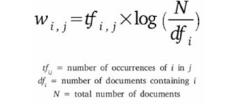
Term Frequency – Inverse Document Frequency (TF – IDF)
Term Frequency (TF) – TF for a term “t” is defined as the count of a term “t” in a document “D”
Inverse Document Frequency (IDF) – IDF for a term is defined as logarithm of ratio of total documents available in the corpus and number of documents containing the term T.
TF . IDF – TF IDF formula gives the relative importance of a term in a corpus (list of documents), given by the following for

Slide 34


Deep-Domain Conversational AI to Power the Next Generation of Voice and Chat Assistants

Slide 35
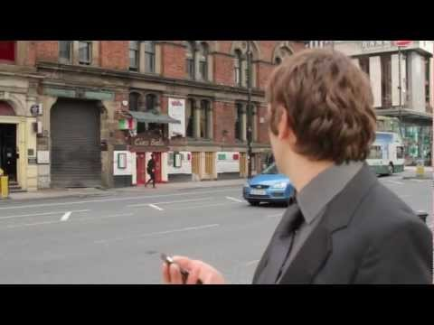

Kngine is an intelligent engine that understands, answers questions and perform actions.
Kngine can be used to automate customer service, power voice interfaces and drive enterprise search.

Slide 36


At EnglishCentral you can choose from thousands of engaging videos, learn words through their interval-based learning system, and then speak and get instant feedback using their proprietary speech assessment technology.

Slide 37
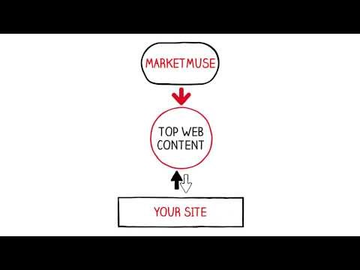

MarketMuse is an AI-assisted platform that helps digital marketers build better content plans and more effective content strategies. Through semantic machine learning on large-scale web content, they evaluate topic relevance and identify low-quality content on your site, identifying topic gaps and improving content performance.

Slide 38



Slide 39
RE
Identifiers:
\d = any number
\D = anything but a number
\s = space
\S = anything but a space
\w = any letter
\W = anything but a letter
. = any character, except for a new line
\b = space around whole words
\. = period. must use backslash, because . normally means any character.

Slide 40
RE
Modifiers:
{1,3} = for digits, u expect 1-3 counts of digits, or "places"
+ = match 1 or more
? = match 0 or 1 repetitions.
* = match 0 or MORE repetitions
$ = matches at the end of string
^ = matches start of a string
| = matches either/or. Example x|y = will match either x or y
[] = range, or "variance"
{x} = expect to see this amount of the preceding code.
{x,y} = expect to see this x-y amounts of the precedng code

Slide 41
RE
White Space Charts:
\n = new line
\s = space
\t = tab
\e = escape
\f = form feed
\r = carriage return
Characters to REMEMBER TO ESCAPE IF USED!
. + * ? [ ] $ ^ ( ) { } | \
Brackets:
[] = quant[ia]tative = will find either quantitative, or quantatative.
[a-z] = return any lowercase letter a-z
[1-5a-qA-Z] = return all numbers 1-5, lowercase letters a-q and uppercase A-Z

Slide 42
Example
>>> import re
>>> mo = re.search("[0-9]+", "Customer number: 232454, Date: February 12, 2011")
>>> mo.group()
'232454'

Slide 43
Example
>>> import re
>>> mo = re.search("([0-9]+).*: (.*)", "Customer number: 232454, Date: February 12, 2011")
>>> mo.group()
'232454, Date: February 12, 2011'
>>> mo.group(1)
'232454'
>>> mo.group(2)
'February 12, 2011'
>>> mo.group(1,2)
('232454', 'February 12, 2011')

Slide 44
Example
>>> import re
>>> mo = re.search("([0-9]+).*: (.*)", "Customer number: 232454, Date: February 12, 2011")
>>> mo.group()
'232454, Date: February 12, 2011'
>>> mo.group(1)
'232454'
>>> mo.group(2)
'February 12, 2011'
>>> mo.group(1,2)
('232454', 'February 12, 2011')

Slide 45
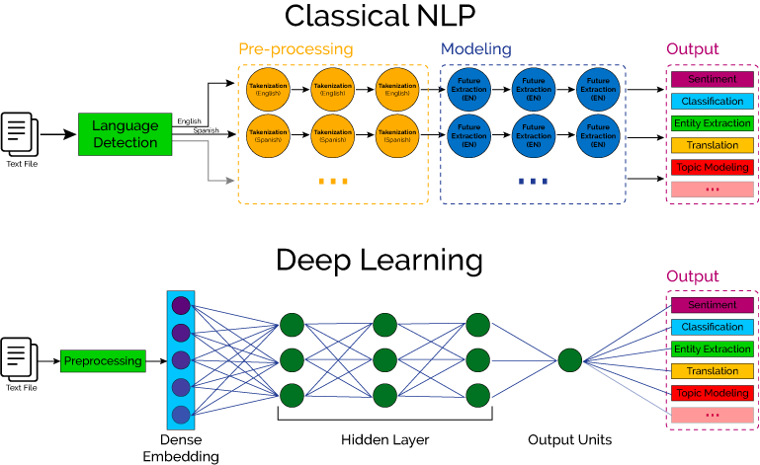
NLP with DL
Classical NLP vs Deep Learning based NLP

Slide 46
JAVA APIs for NLP
Document Analysis Platform (DAP)
https://github.com/document-analysis/dap
Apache OpenNLP
https://opennlp.apache.org/
Stanford NLP
https://nlp.stanford.edu/
Framenet
https://framenet.icsi.berkeley.edu/fndrupal/

Slide 47
Python APIs for NLP
NLTK http://www.nltk.org/book/
Textblob https://textblob.readthedocs.io/en/dev/index.html
Stanford Core NLP https://stanfordnlp.github.io/CoreNLP/index.html
spaCy https://spacy.io/
Genism https://radimrehurek.com/gensim/

Slide 48
Resources:
Deep Learning for Natural Language Processing
University of Oxford (Highly Recommended)
https://github.com/oxford-cs-deepnlp-2017/lectures/blob/master/README.md
Natural Language Processing (NLP)
Microsoft
https://www.edx.org/course/natural-language-processing-nlp-microsoft-dev288x
CS224n: Natural Language Processing with Deep Learning
http://web.stanford.edu/class/cs224n/

Slide 49
Thank You
Anshu Pandey
Enjoy Learning ! Explore Technology!

